Slide 1

Steganalysis In
Photographs
Presented by
Devadi Yekaditya
Mislah Rahman
Sriramsetty Bhanu Teja
Under the guidance of
Dr. Amit Ranjan Azad
INDIAN INSTITUTE OF INFORMATION TECHNOLOGY KALYANI

Slide 2

01
INTRODUCTION
02
IMAGE
03
INFORMATION
SECURITY
04
STEGANOGRAPHY
05
STEGANALYSIS

Slide 3


Introduction

Slide 4

Types of Multimedia
Text
Audio
Image

Slide 5

Image
What is image?.

Slide 6

RGB COLOR MODEL
RGB uses combination of red, green, and blue channels to create various colors.
Each value in the Image Matrix corresponds to a color or Intensity at a specific location.

Slide 7
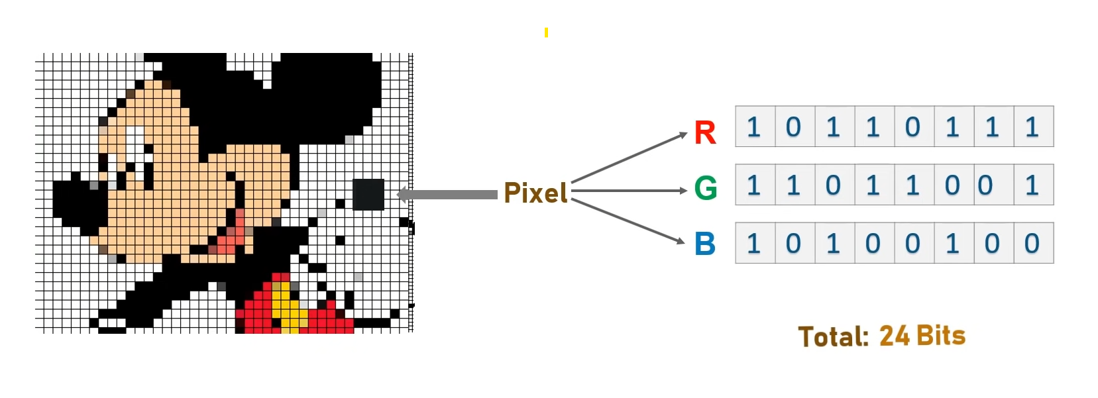
Image Representation
Raster and Vectors
Pixel

Slide 8
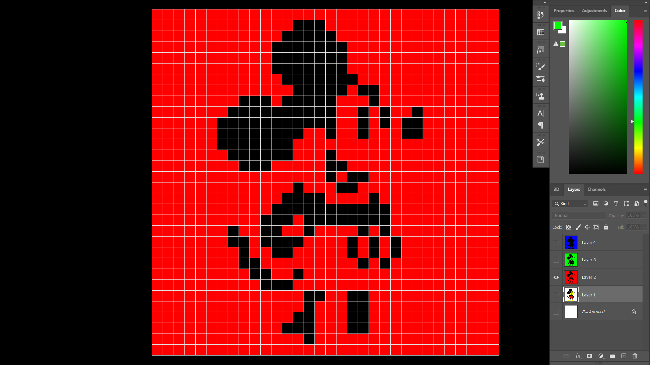
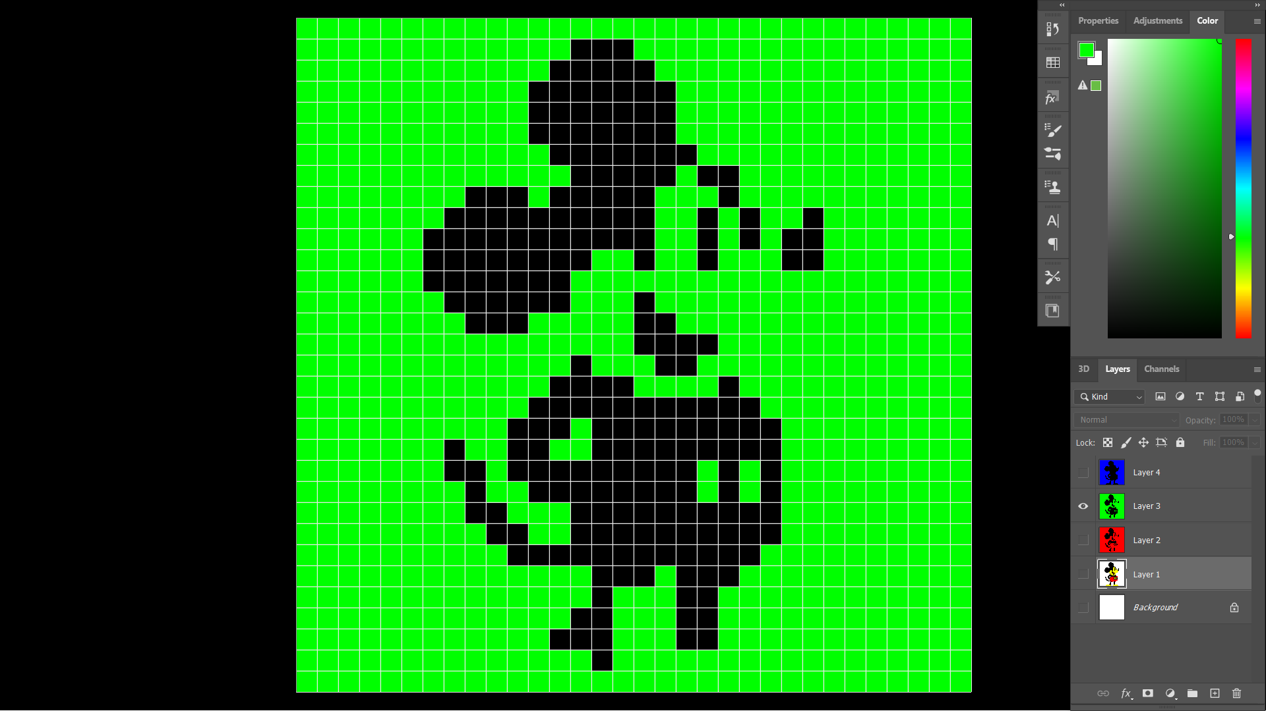
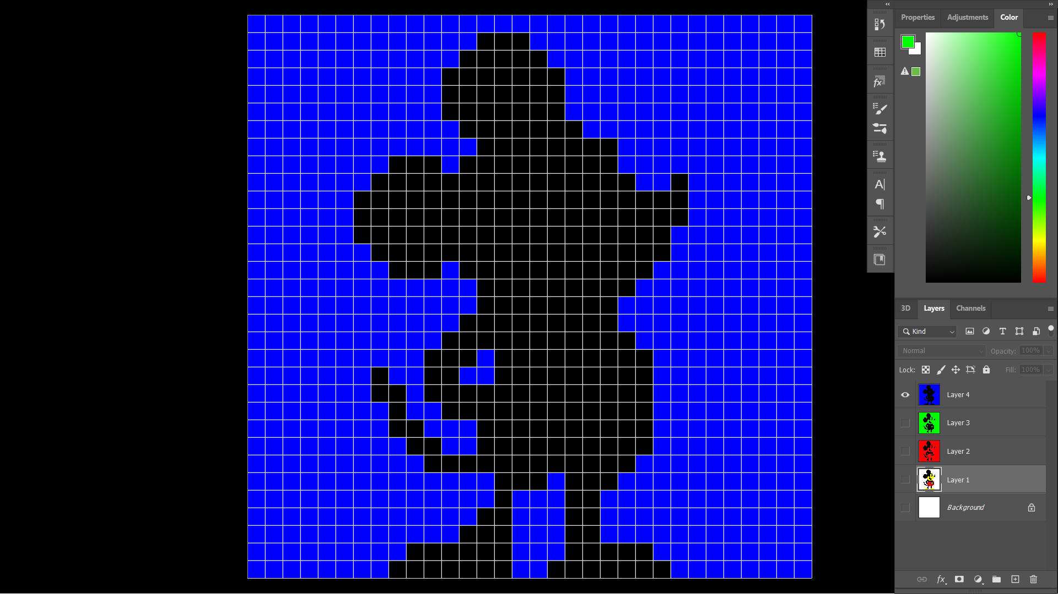
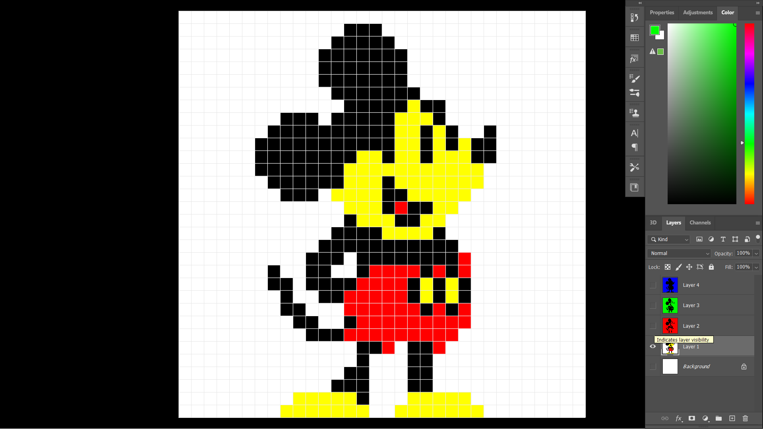
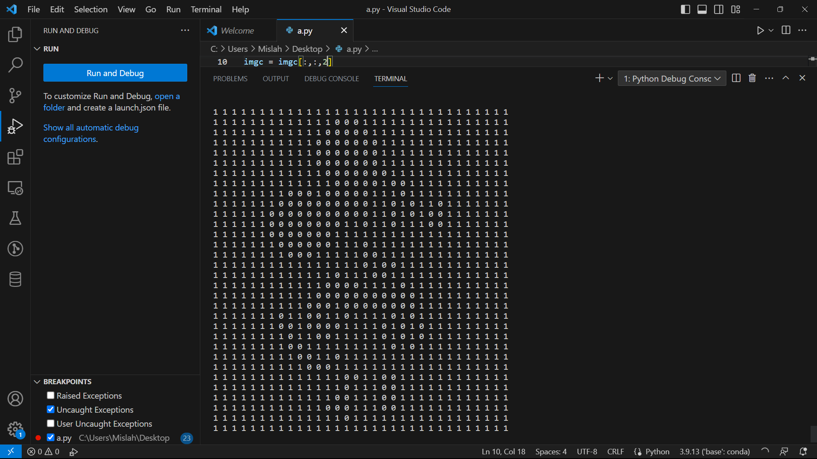
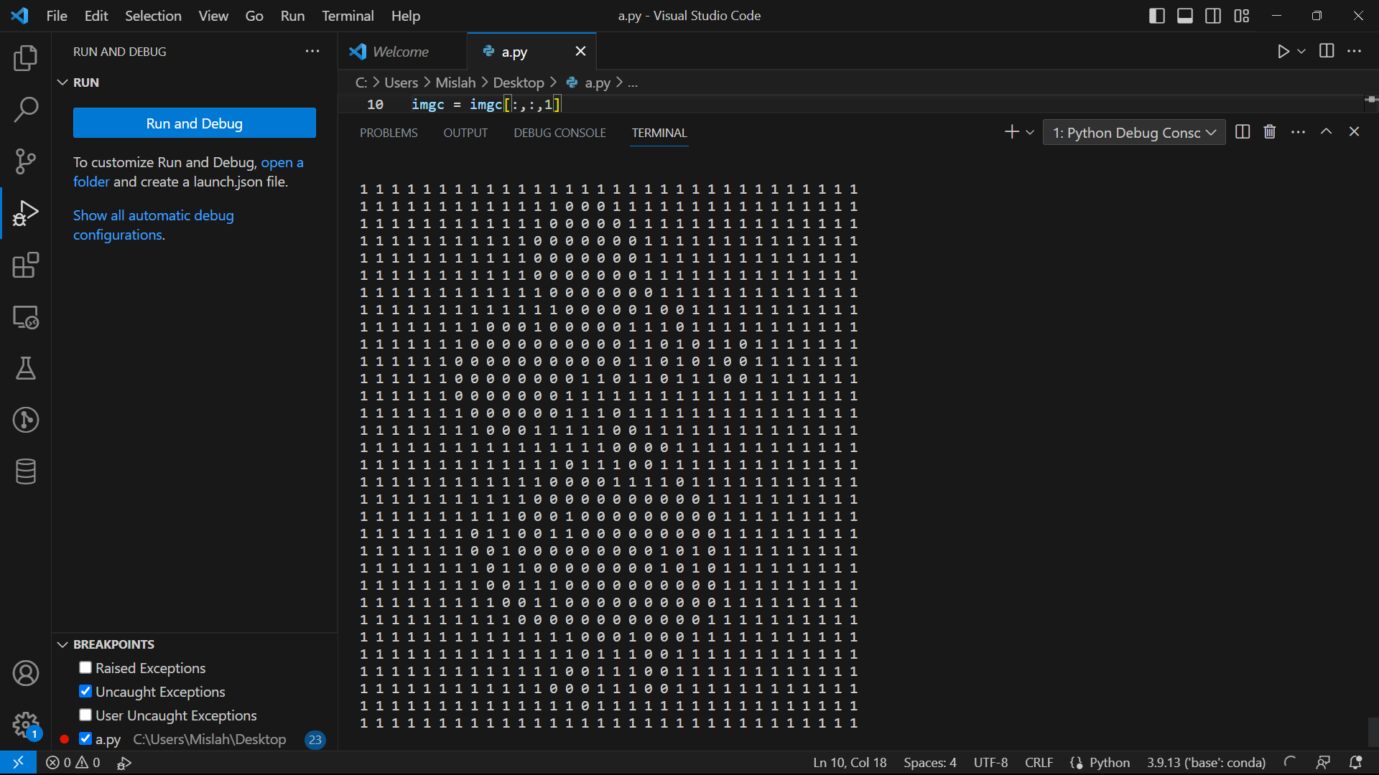
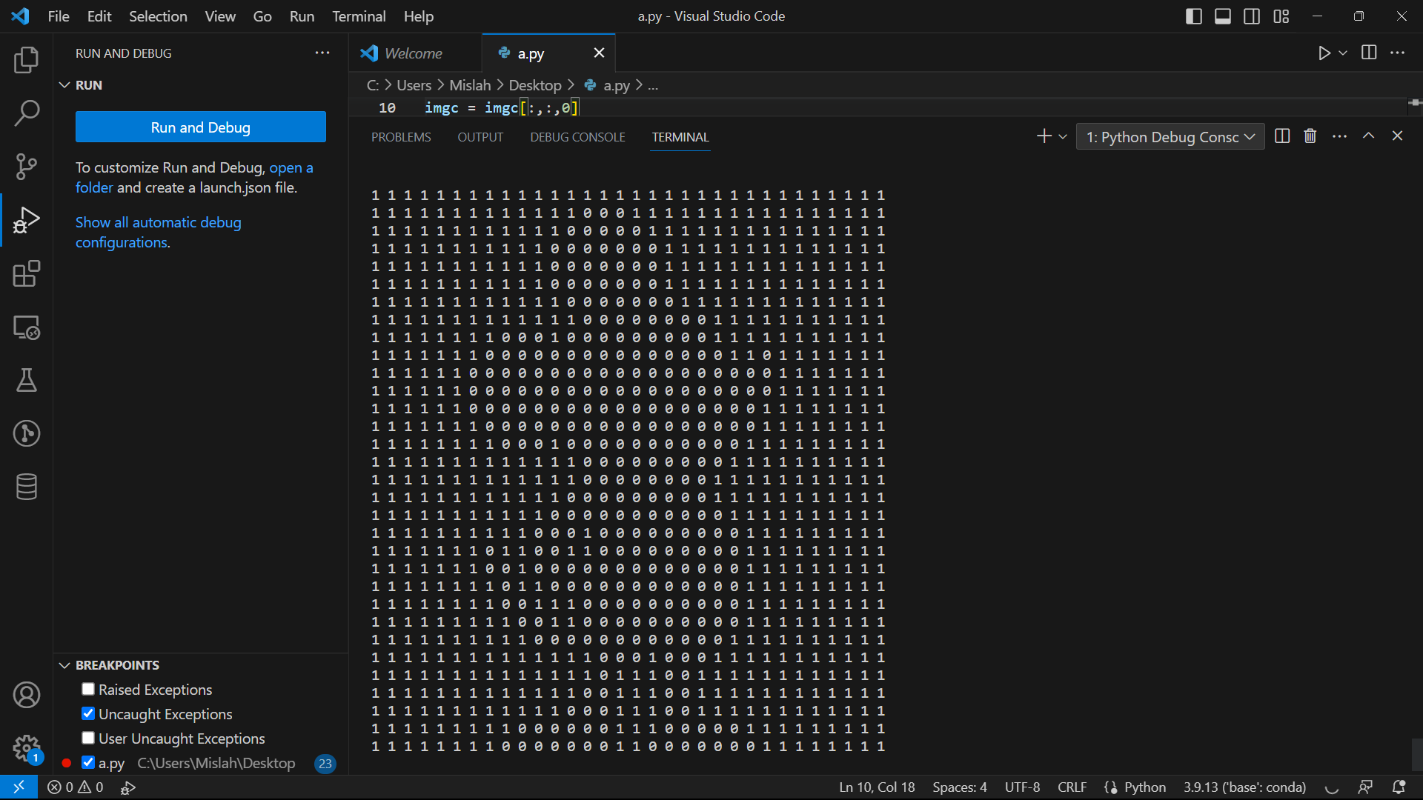
Matrix
Representation
Red
Green
Blue

Slide 9
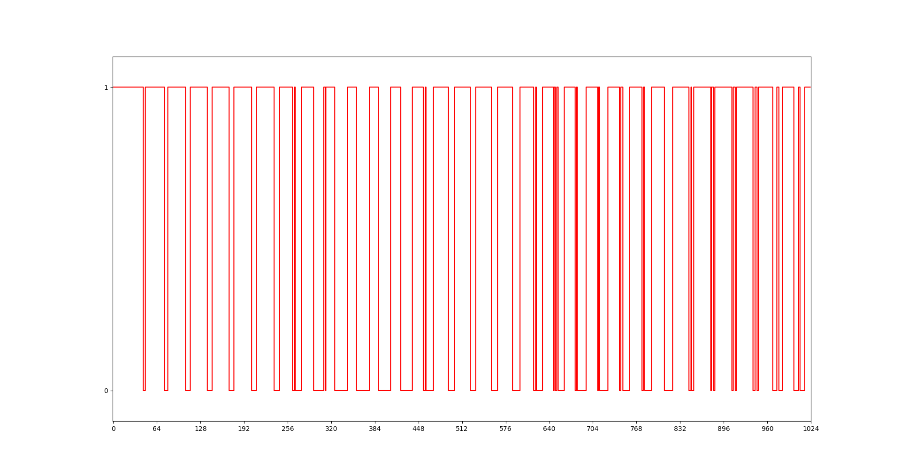
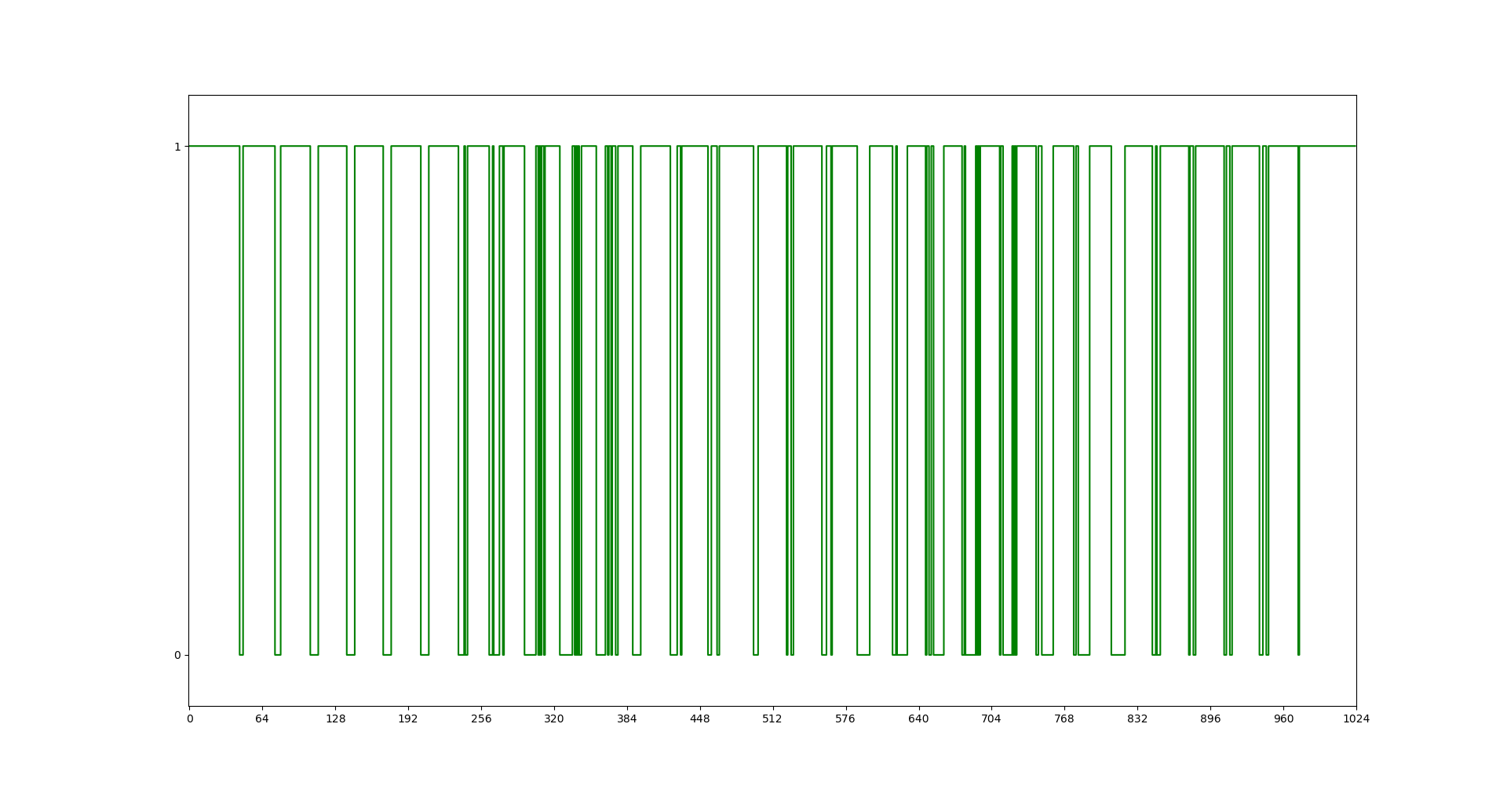
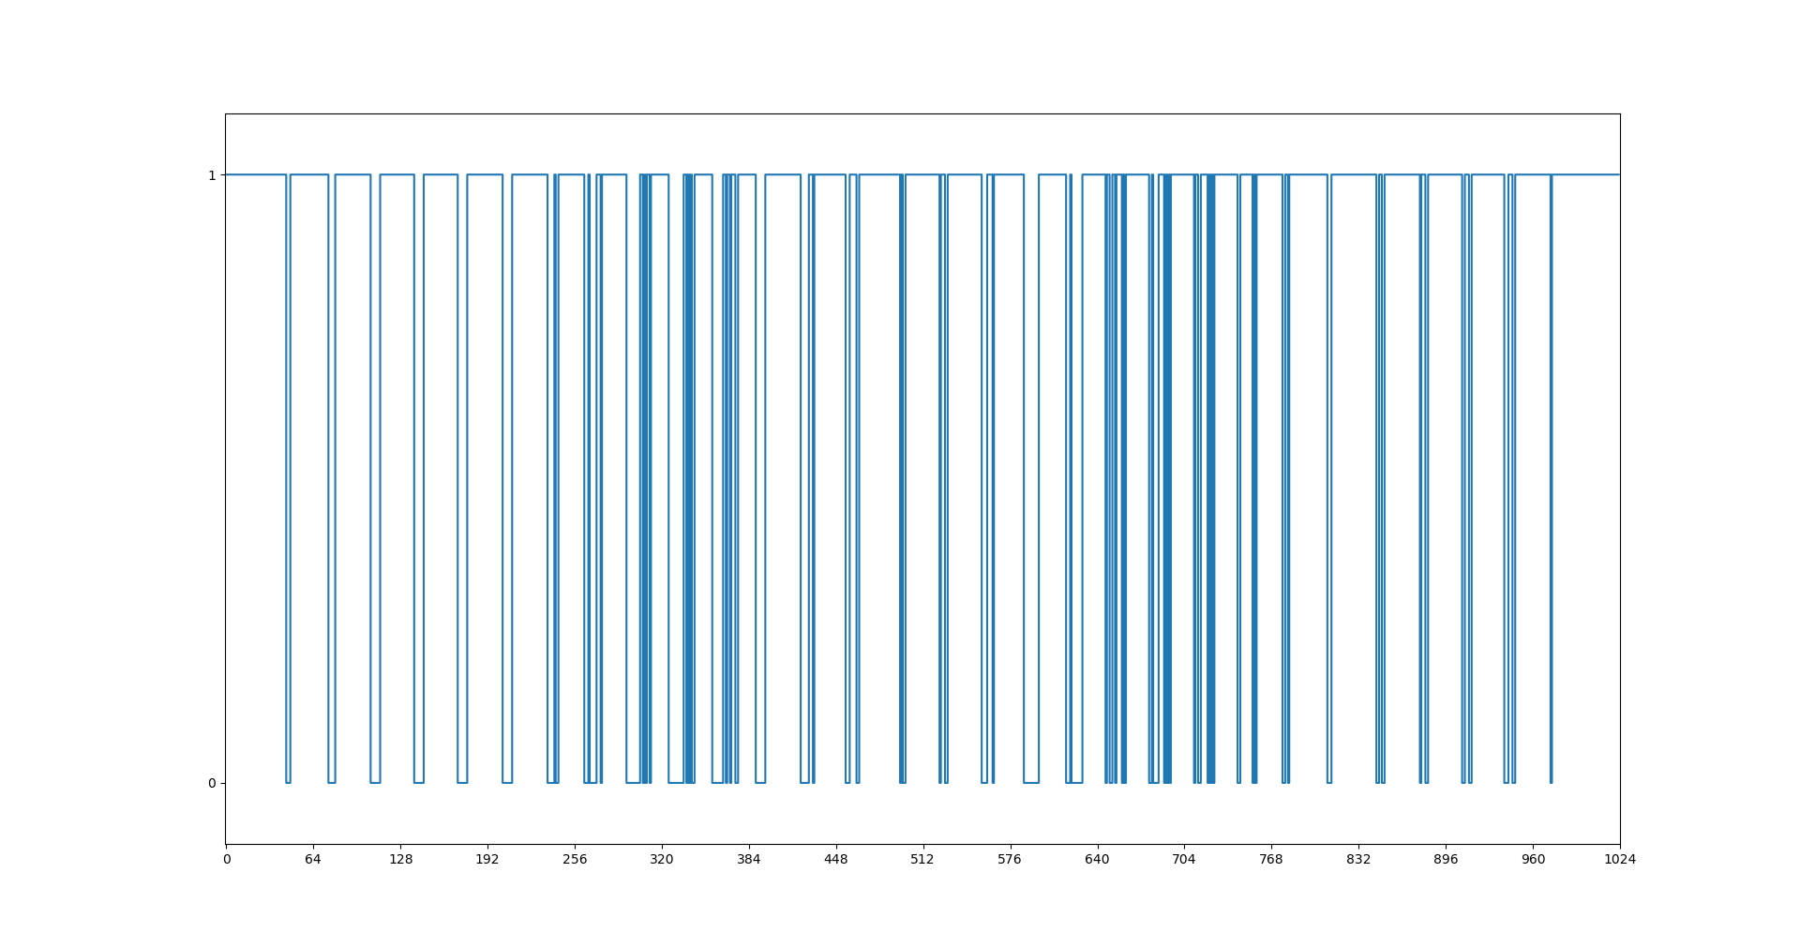
Signal Representation
Red
Green
Blue

Slide 10

Image Compression
Image Compression is a process applied to a graphics file to minimize in bytes without degrading image quality below an acceptable threshold.
Types of Compression
Lossy
Lossless

Slide 11

Information Security
Cryptography
Steganography

Slide 12
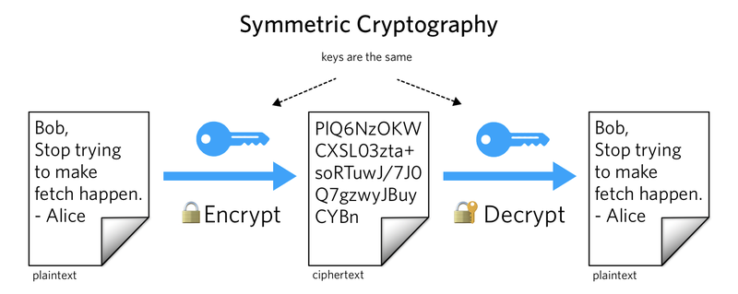
Cryptography
Hides information by encoding it. Information is unreadable without key.

Slide 13
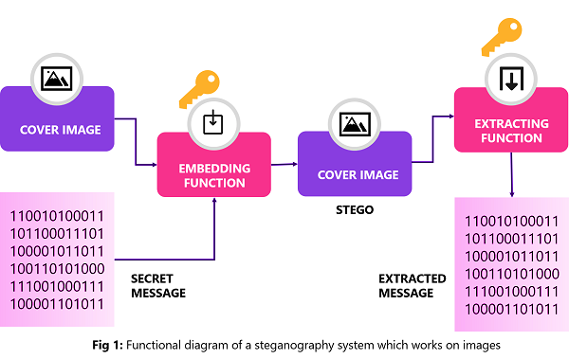
Steganography
Hides information by concealing it. The presence of information is not known.
Since everyone can read, encoding text in neutral sentences is doubtfully effective.
Since everyone can read, encoding text in neutral sentences is doubtfully effective.

Slide 14

Types of Steganography
Spatial Domain
Frequency Domain

Slide 15
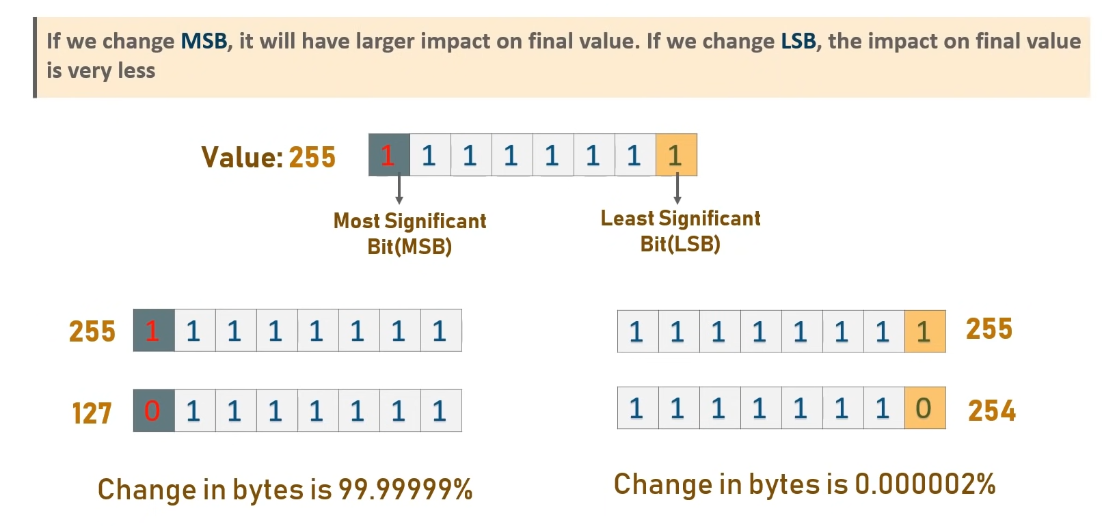
LSB Steganography

Slide 16

LSB Steganography
<how to make lsb steganography>

Slide 17
LSB Steganalysis
What is steganalysis
<what our project doing>

Slide 18


LSB Steganography
+
=
Cover image
Payload

Slide 19
=
Embedded Image

Slide 20
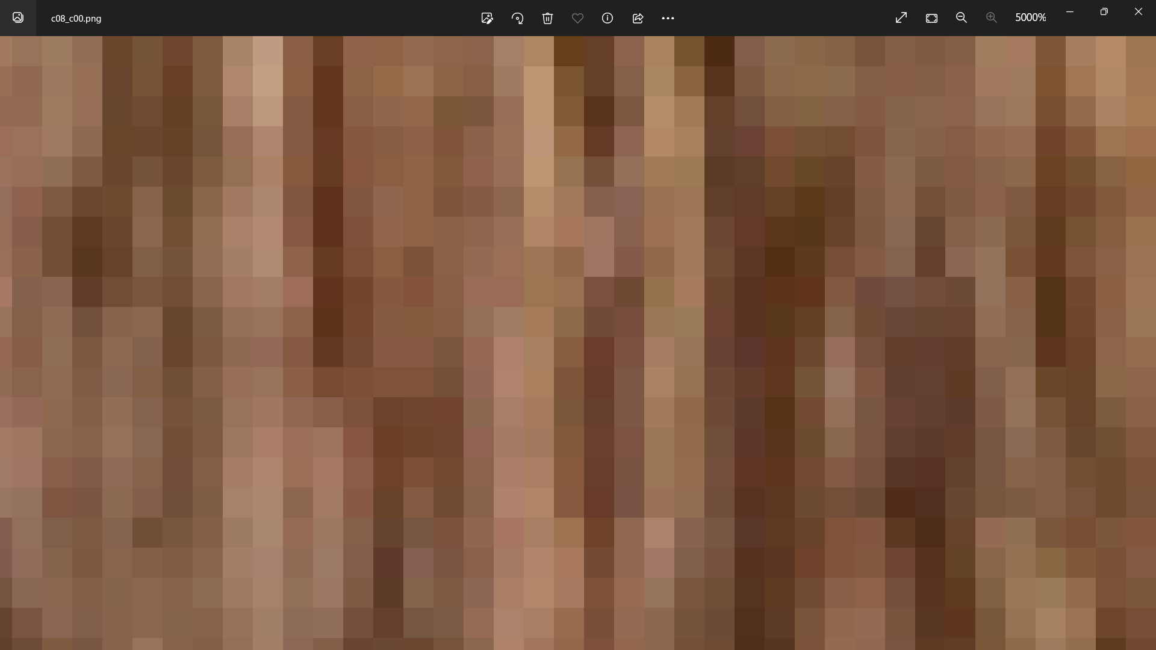
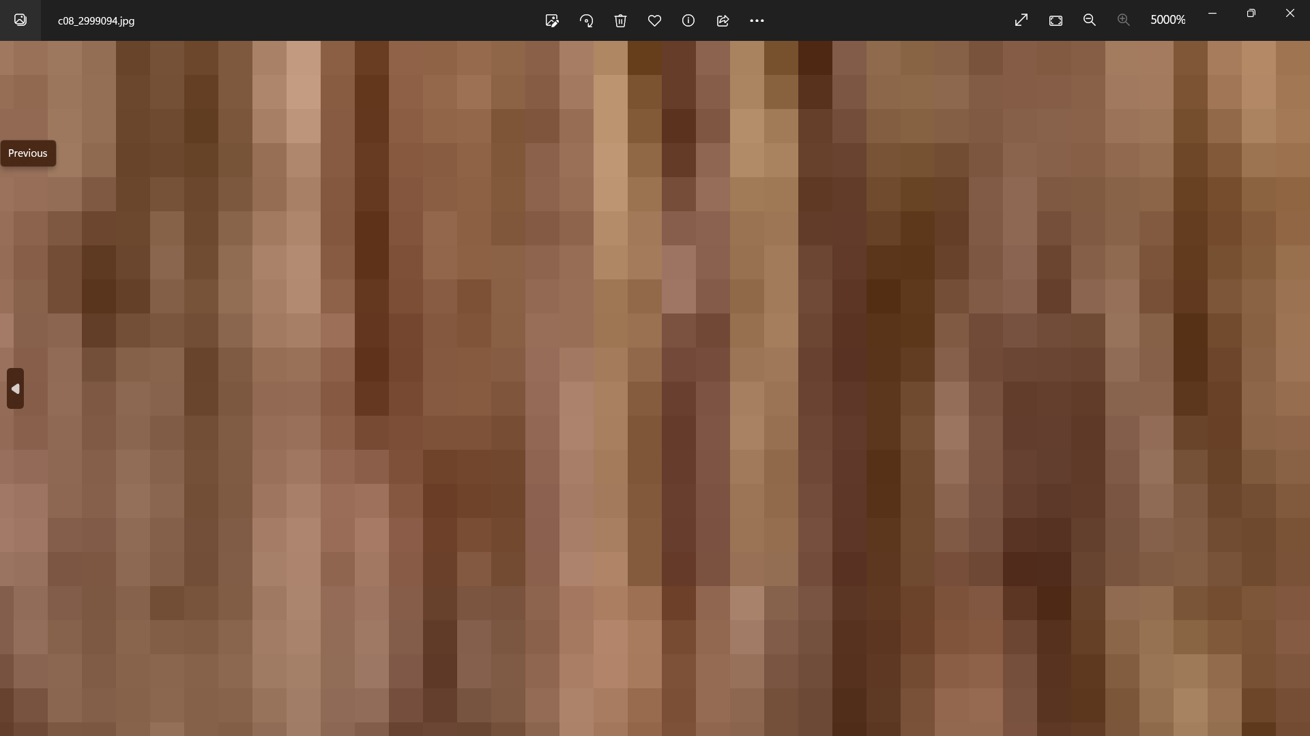
Cover image
Embedded Image

Slide 21
Cover image
Embedded Image

Slide 22
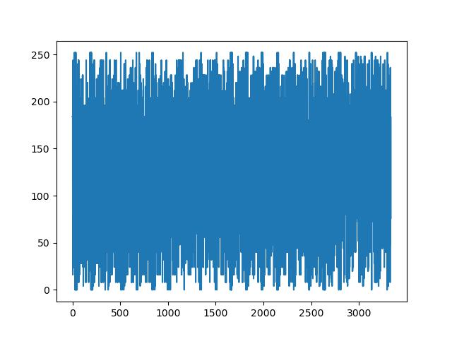
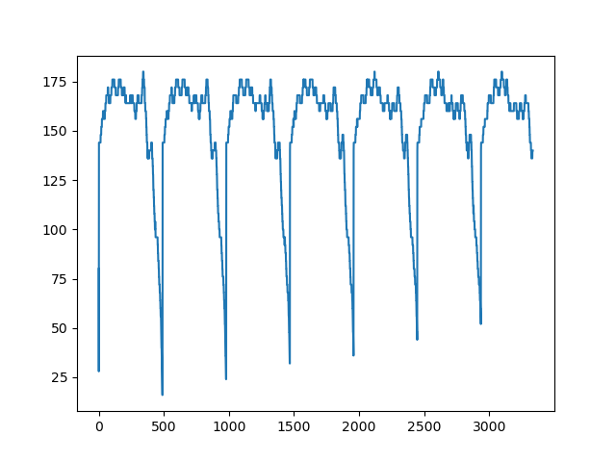
Cover image
Embedded image

Slide 23
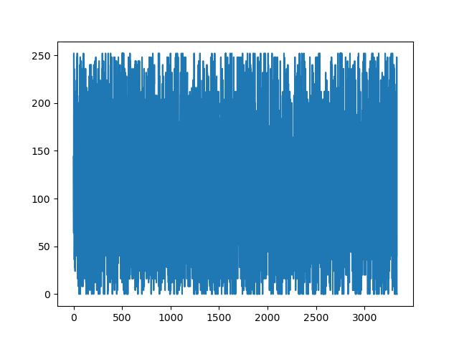
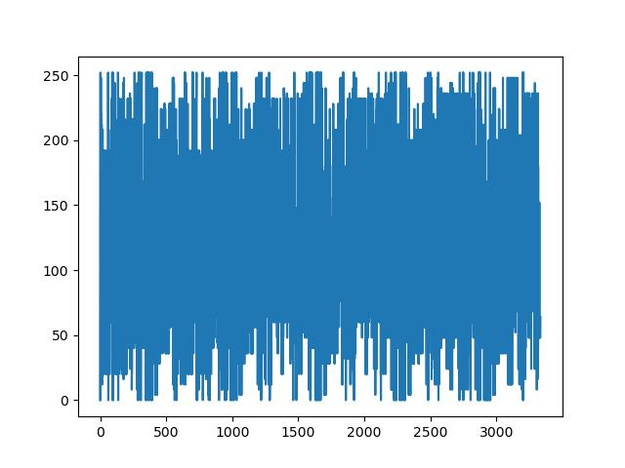
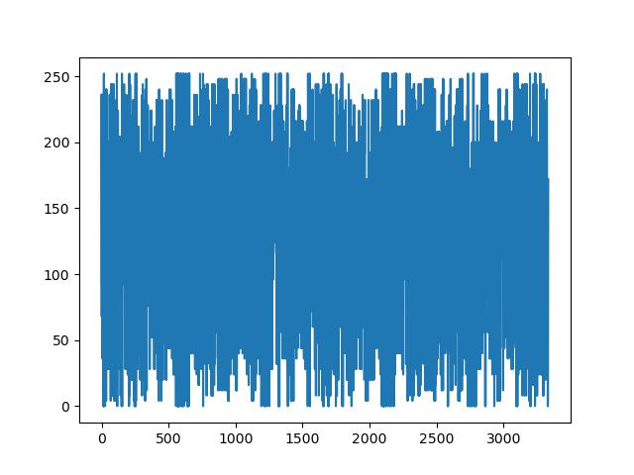
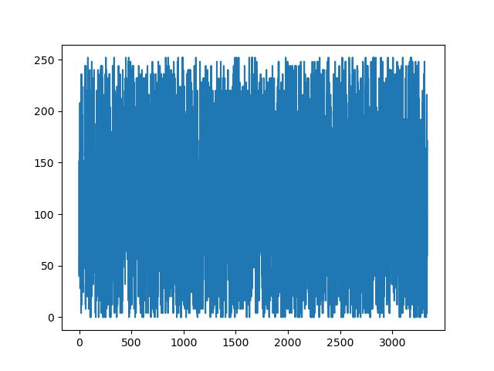
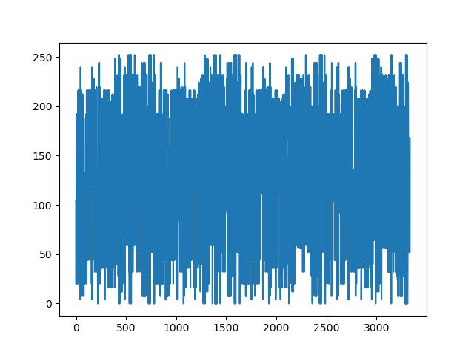
Observations
Photographs

Slide 24


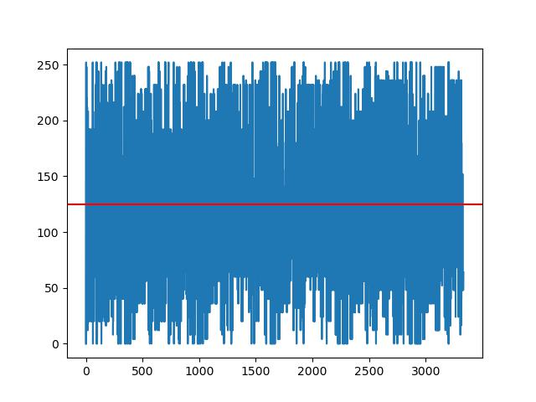

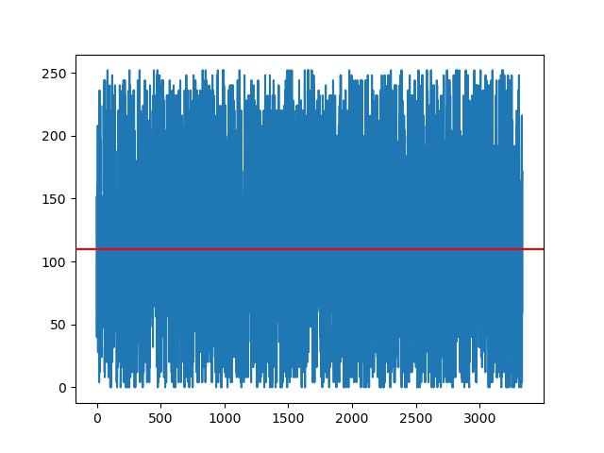

Observations
Photographs

Slide 25
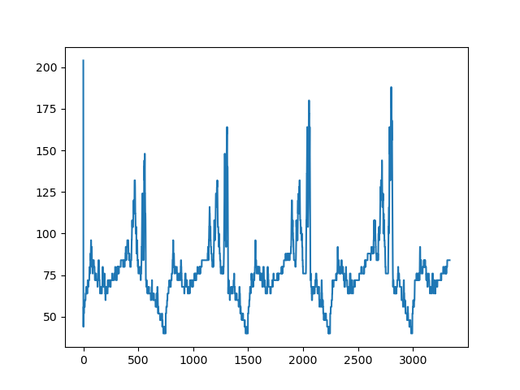
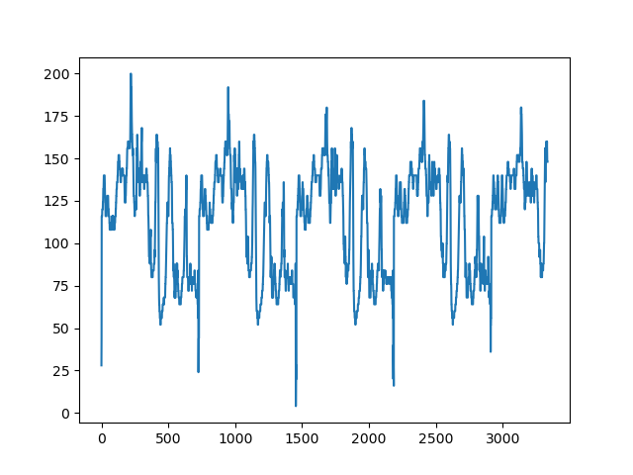
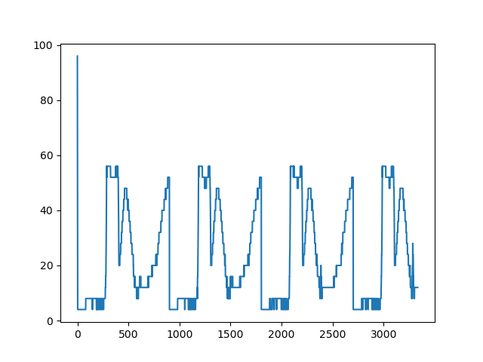

Observations
Embedded Images
Cover Images follows uniform distribution
Embedded images has repeating patterns.
Embedded images has high information density

Slide 26
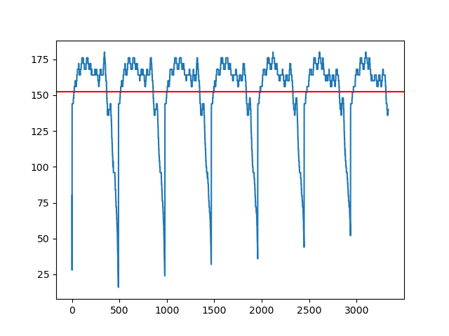
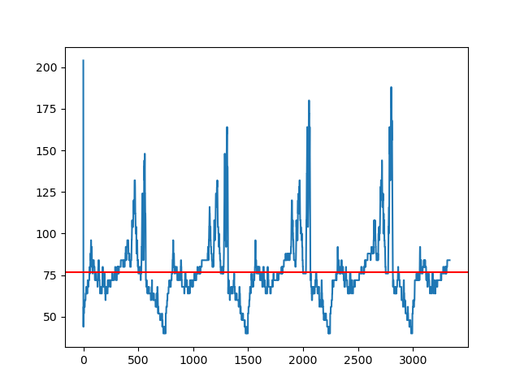
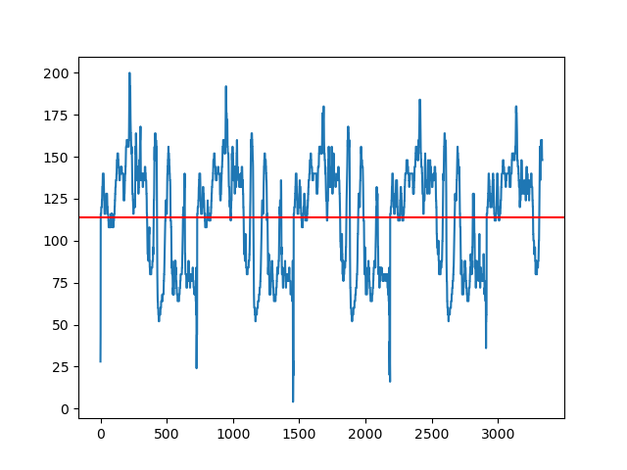
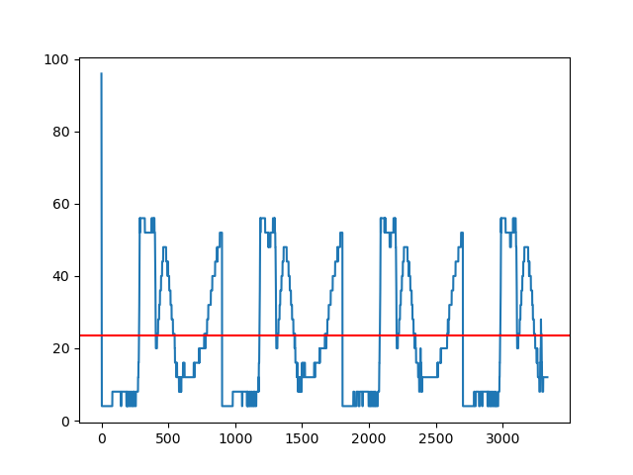
Observations
Embedded Images
Cover Images follows uniform distribution
Embedded images has repeating patterns.
Embedded images has high information density

Slide 27
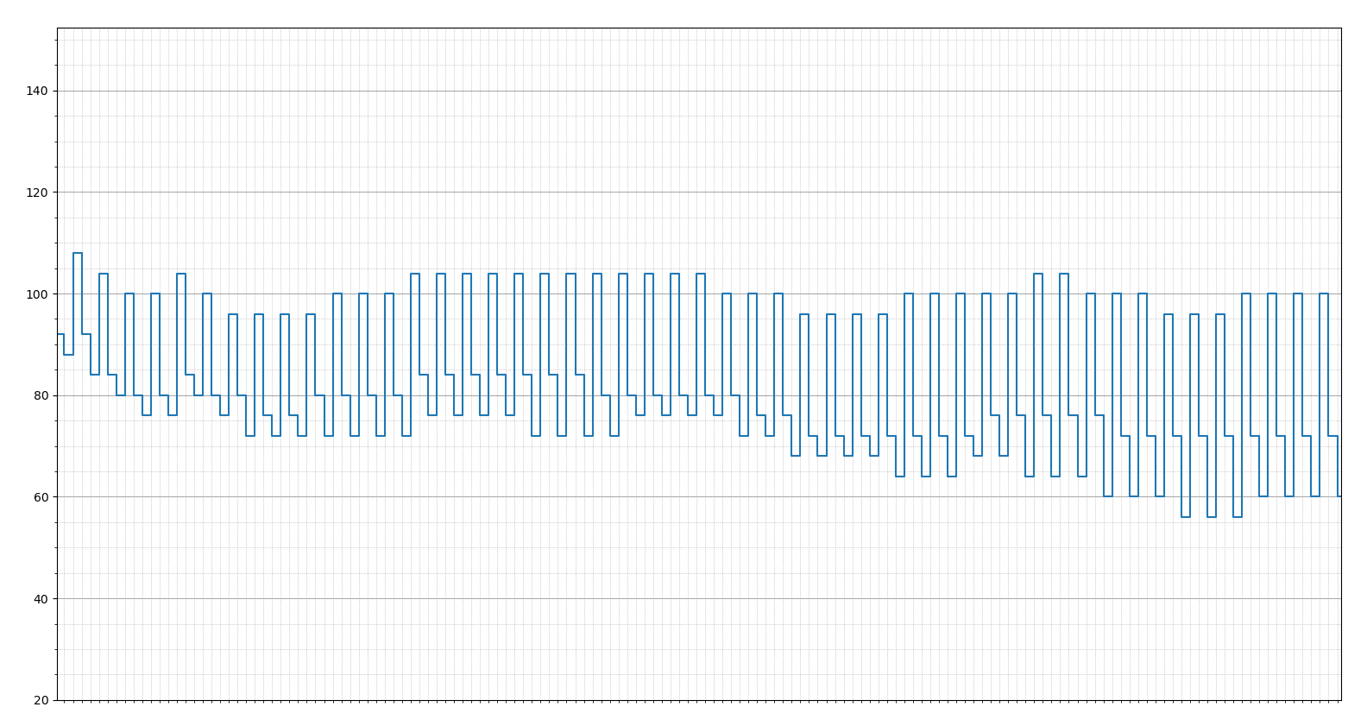
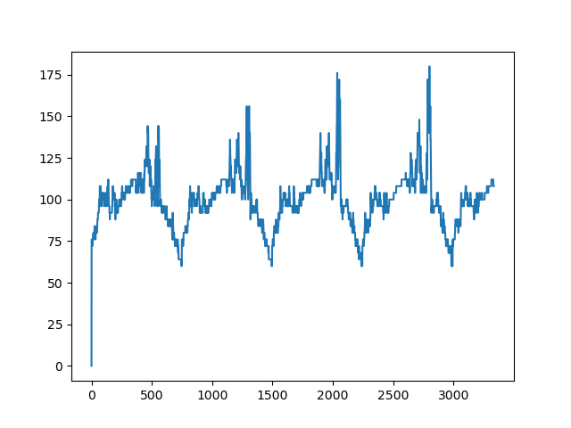
Statistical Analysis

Slide 28

Discrete Cosine Transform
DCT
<find picture of dct from internet>
<and equation also>

Slide 29
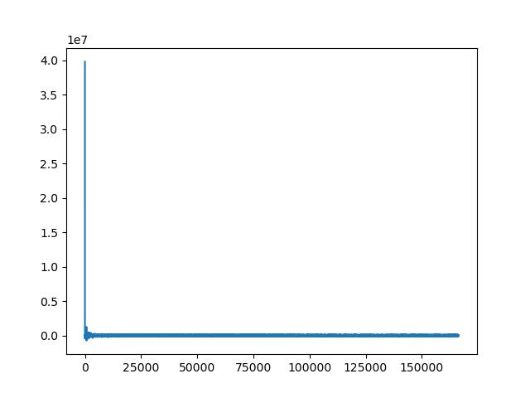
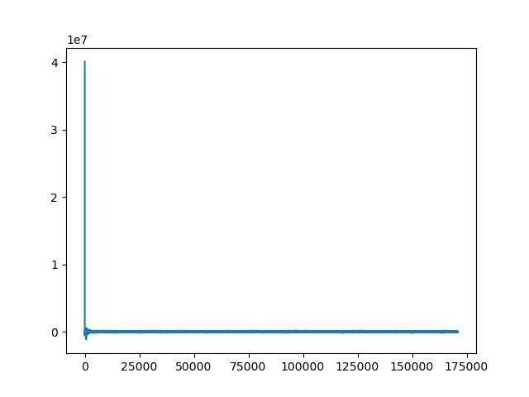
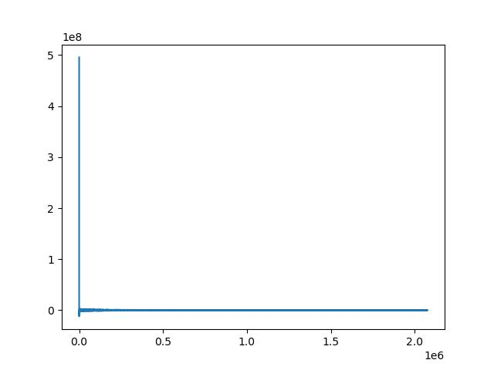
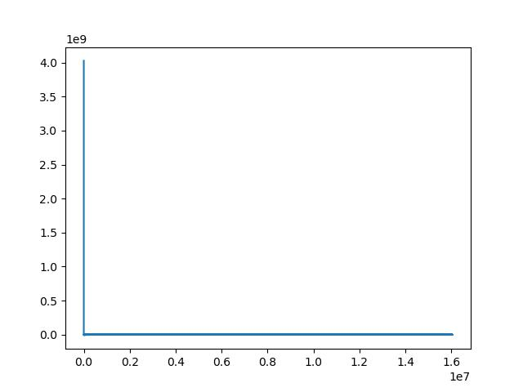
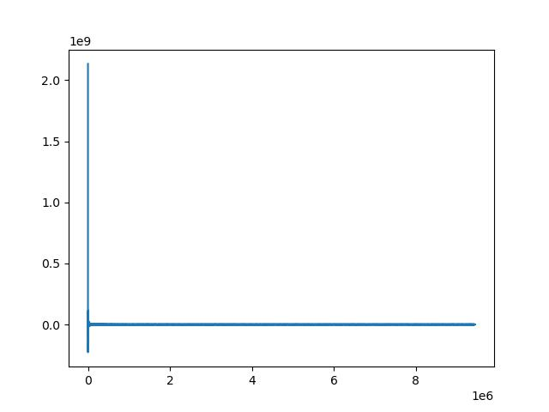
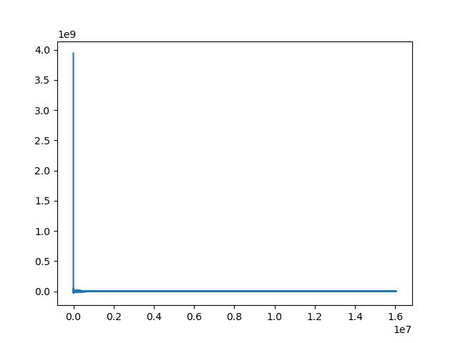
Discrete Cosine Transform
Photographs

Slide 30
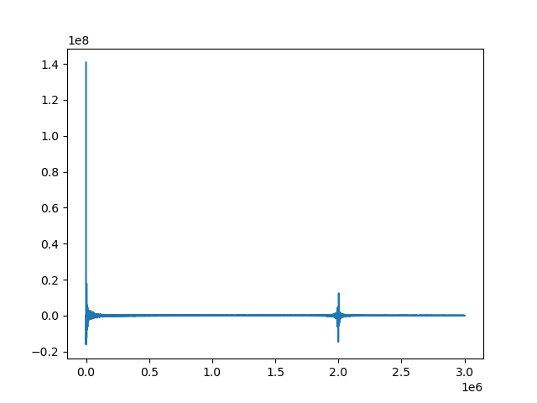
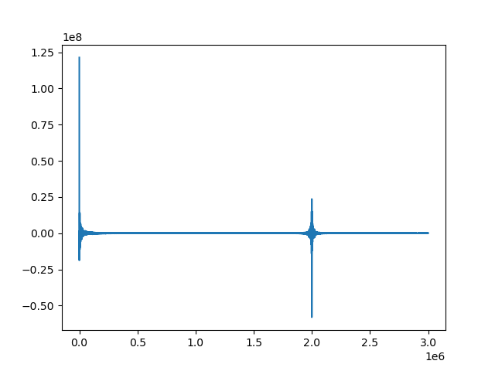
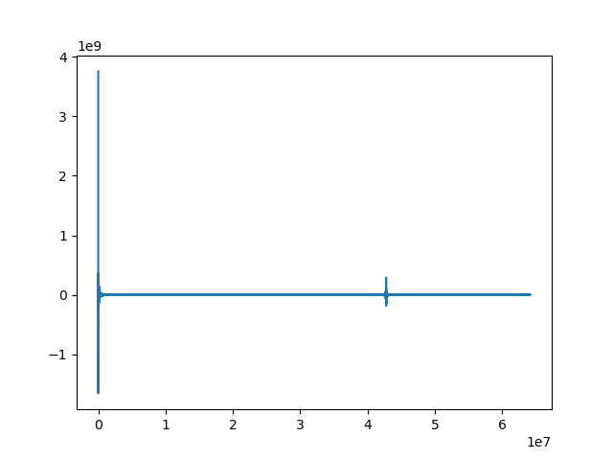
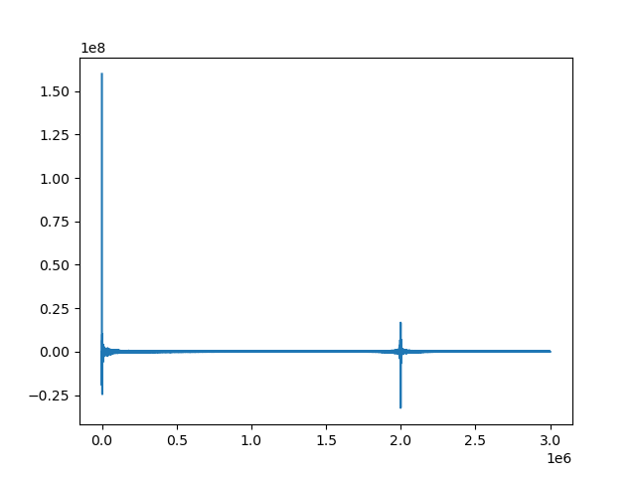
Discrete Cosine Transform
Embedded Image
Cover Images has a one very large spike near to zero
Embedded images two large spikes.

Slide 31

Decoding of Image
+
Cover image
Payload

Slide 32
Decoding of Image
Embedded Image

Slide 33
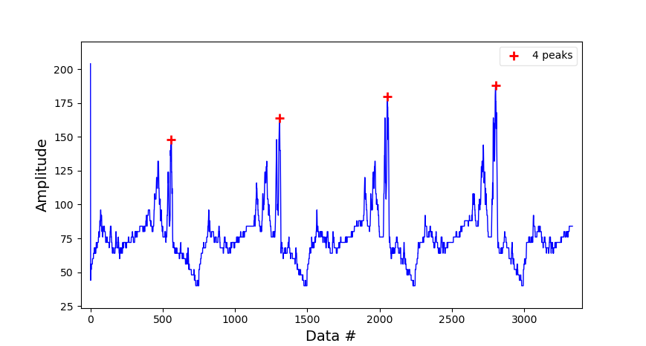
Decoding of Image

Slide 34
Decoding of Image
Mean distance between peaks = 747
748
745
749
Original dimensions
of payload image: 748 x 499

Slide 35
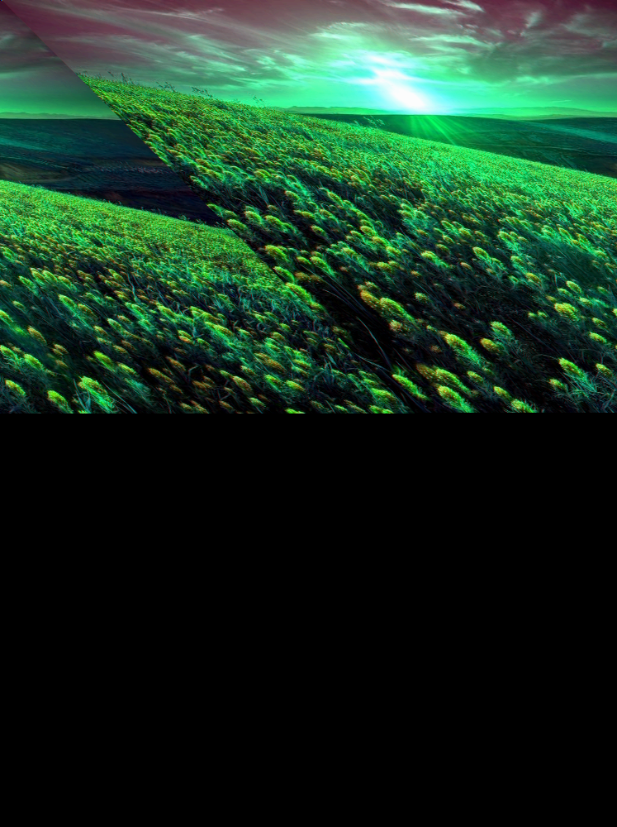


Decoding of Image
width = mean
width = mean
After channel offset correction
width corrected
After channel offset correction

Slide 36

Application
Applications of steganalysis

Slide 37
Future Scope
Machine learning to detect patterns
Decoding

